Slide 1


Reconstruction of 3D cellular behavior
Chanhong Min, Hyunji Park, Anubhav De, Emily Guan
Machine Learning

Slide 2
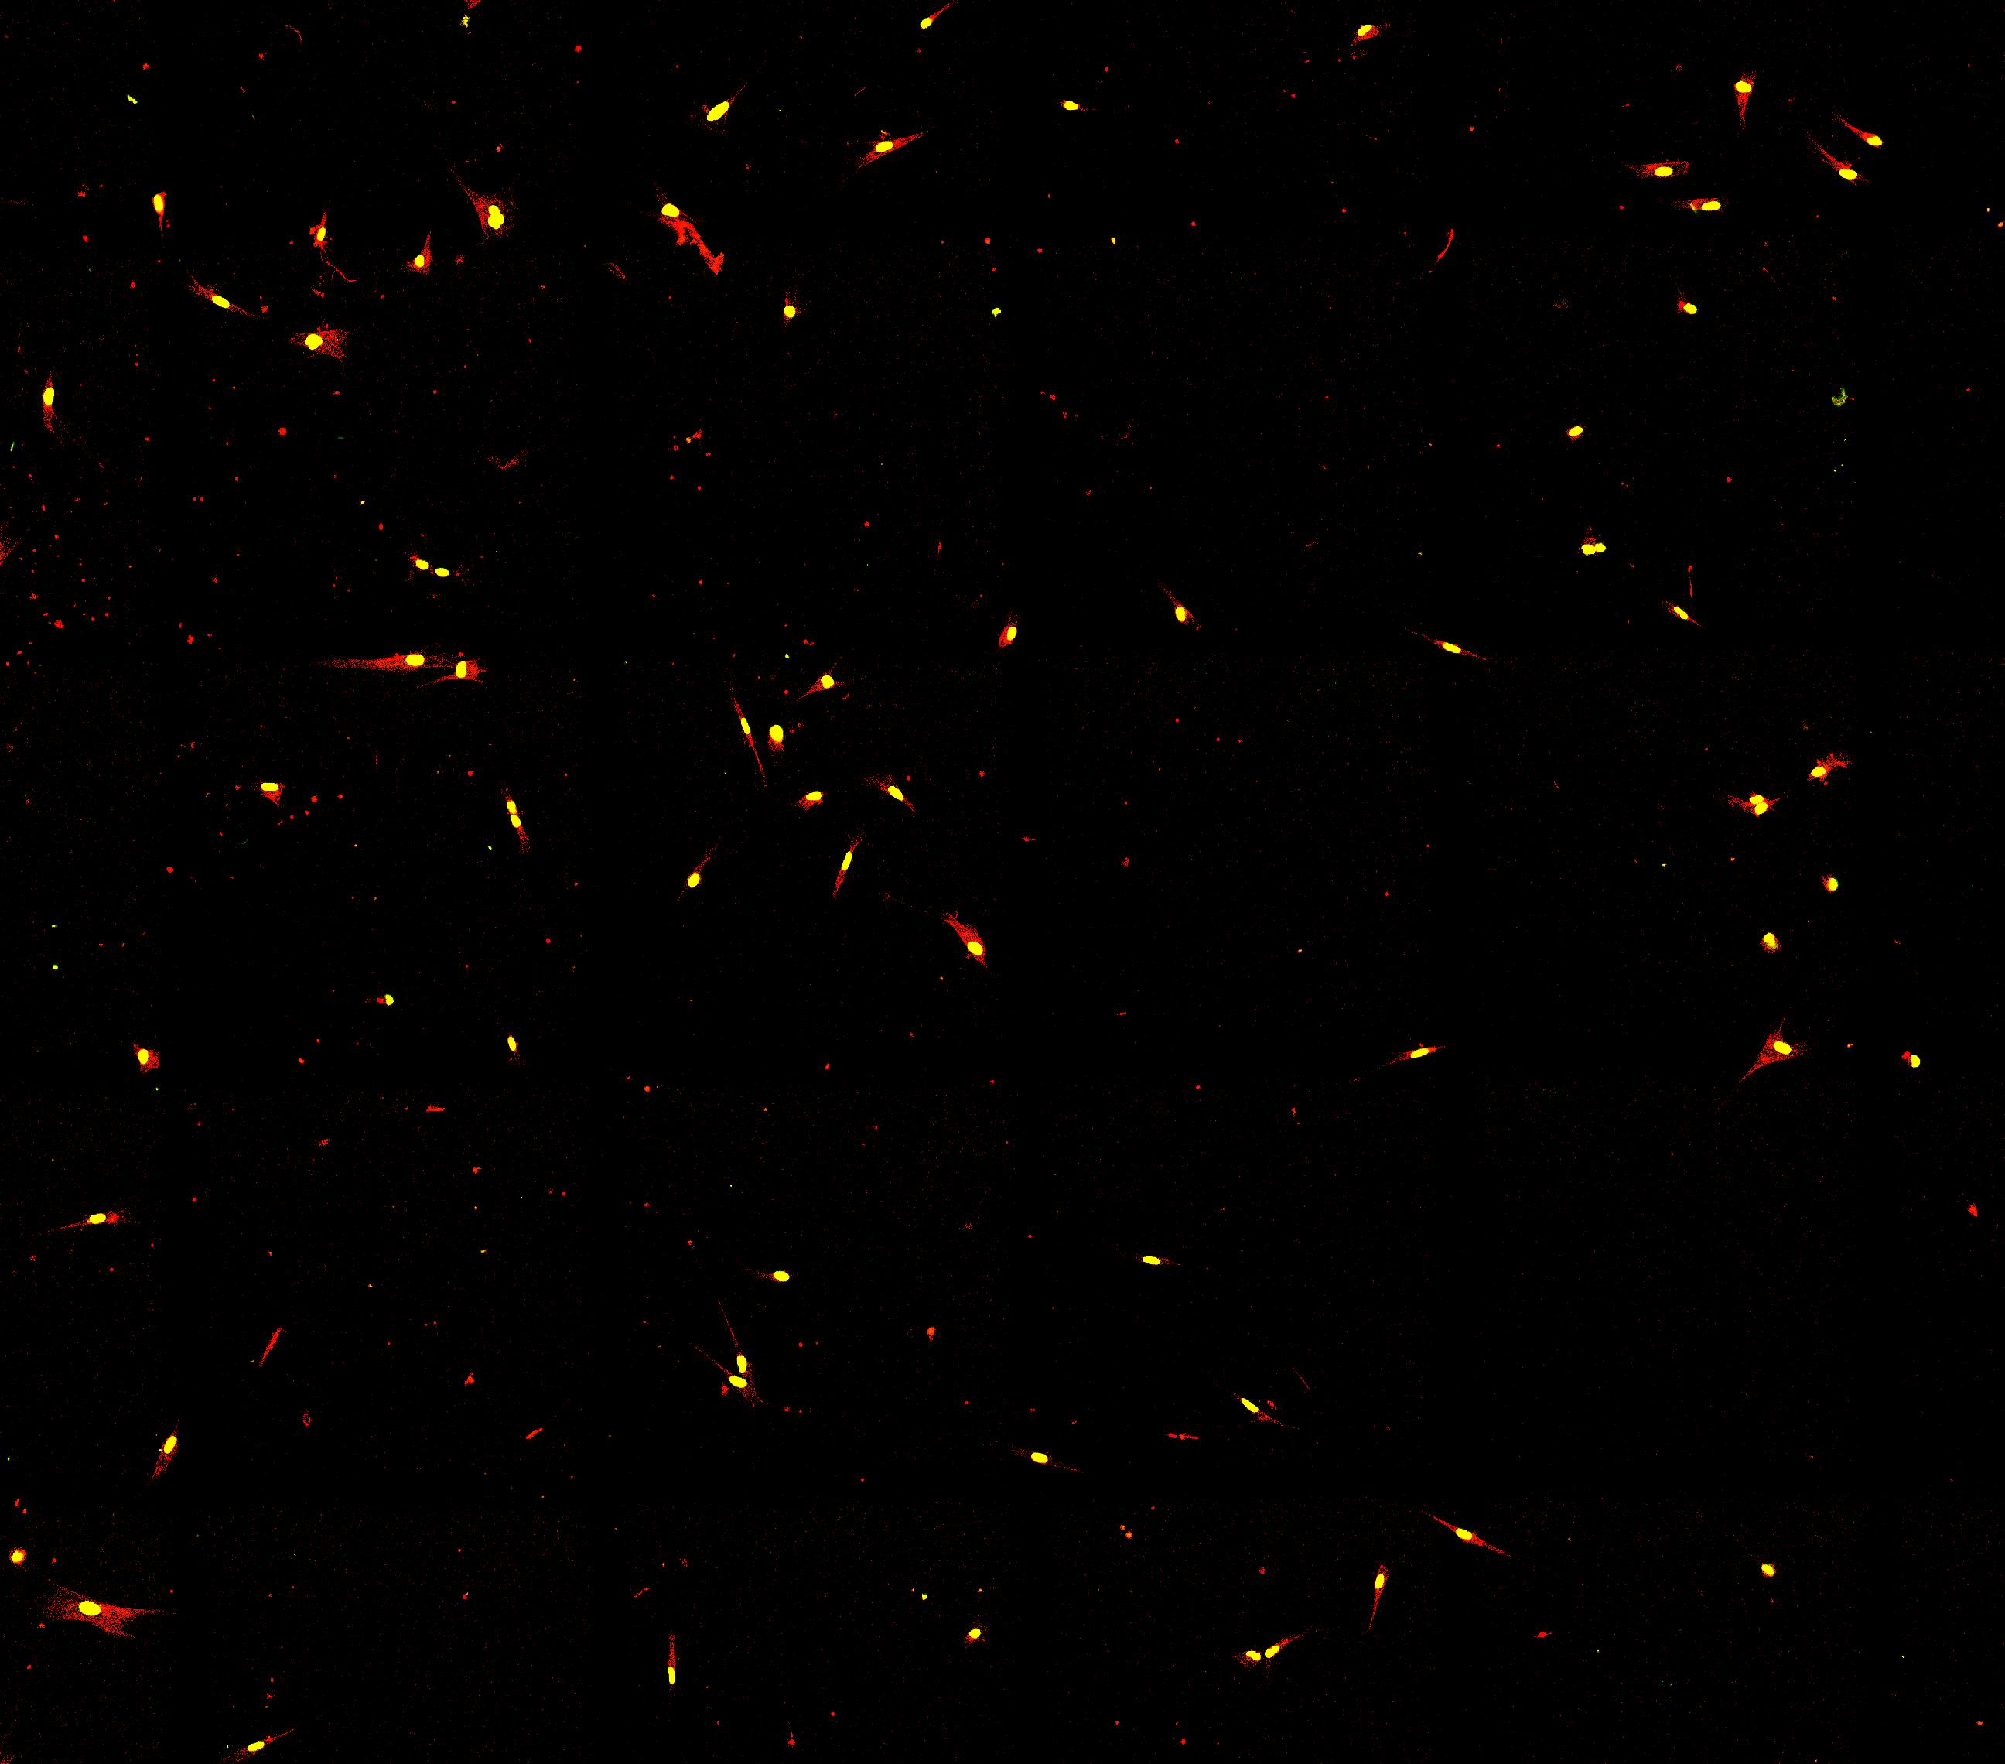
Time lapse imaging is critical in biology research
Time-lapse imaging
Immunology
Development
Would healing
Disease i.e., cancer metastasis
2D imaging
Simple to image
Less computational complexity
3D cannot handle high temporal resolution
Notes:
In biology, time lapse imaging is very fundamental technology that we can get great depth of insights for instance, how immune cells move and function, study of developmental period, wound healing and pathological conditions like cancer metastasis.
We still use 2D imaging instead of 3D due to its simplicity in terms of imaging, less computational complexity.
Also, since 3D requires additional z-direction to be stacked, 3D time-lapse often suffers from low temporal resolution.

Slide 3
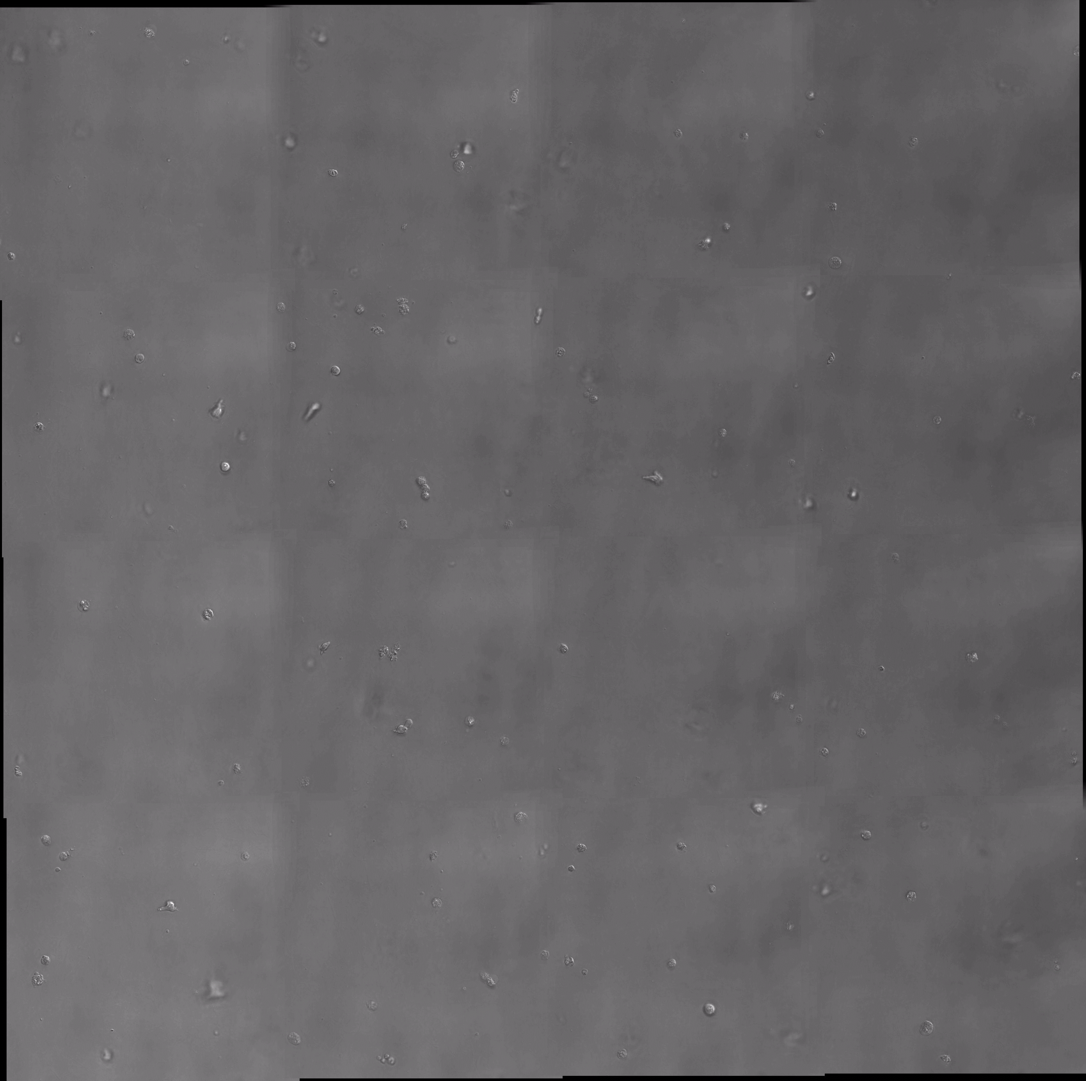
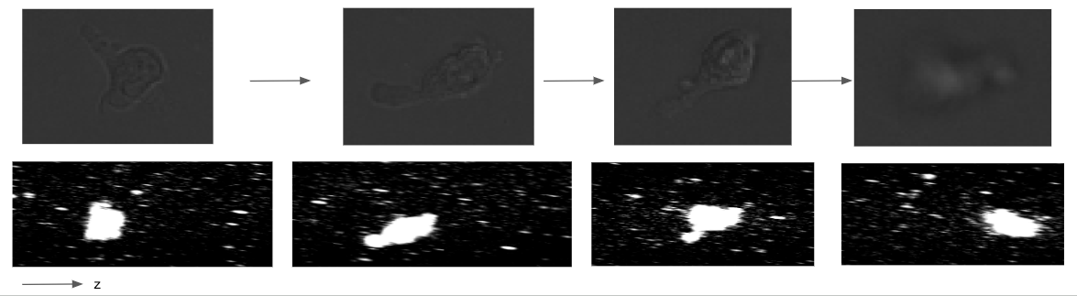
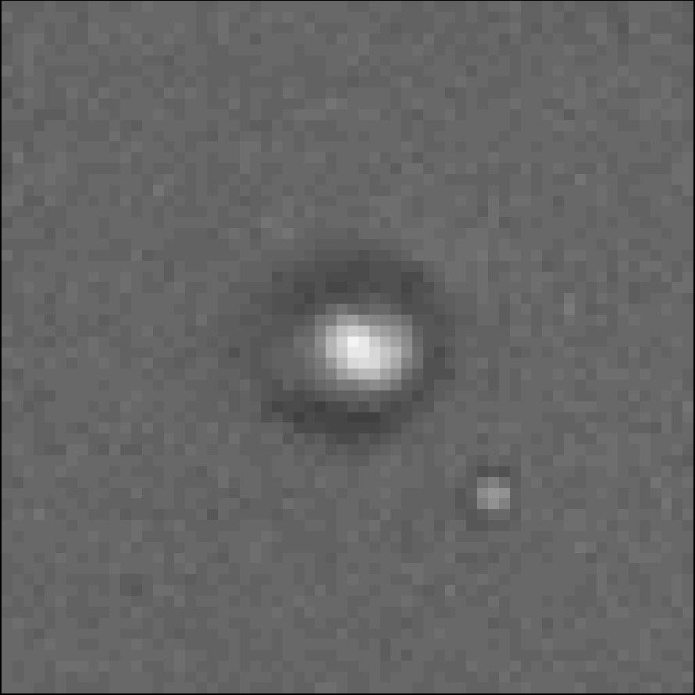
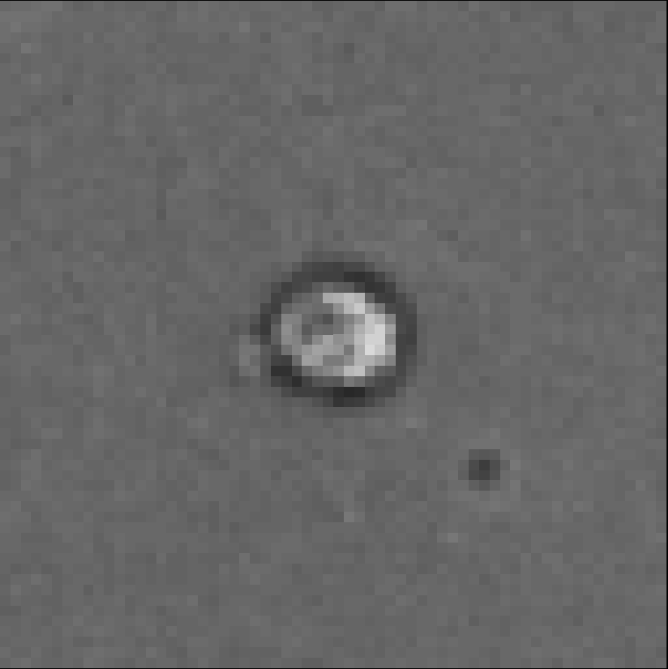
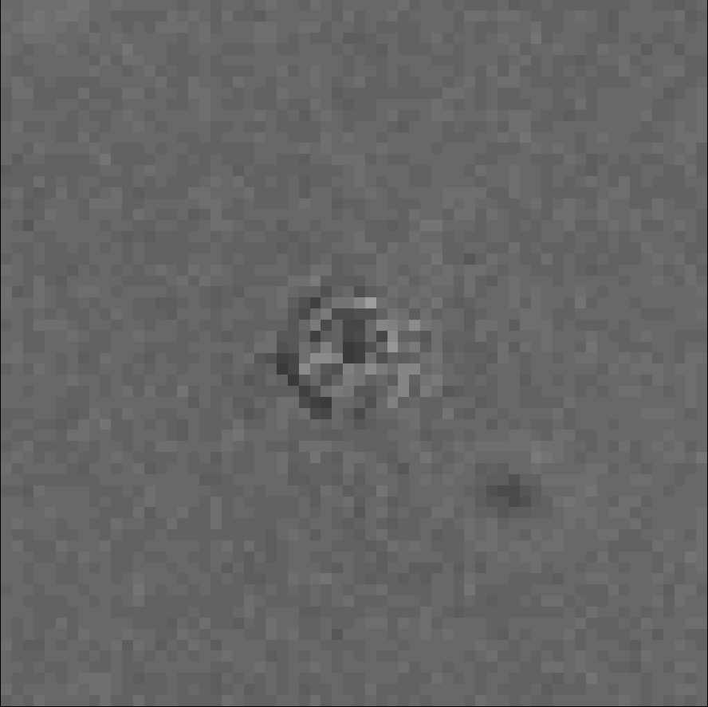
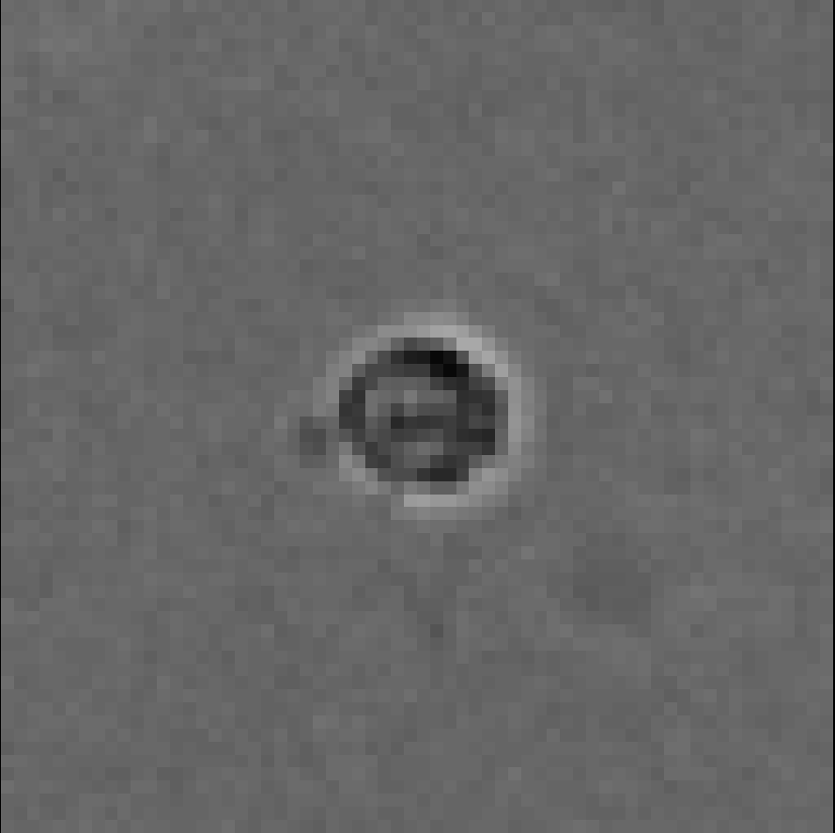
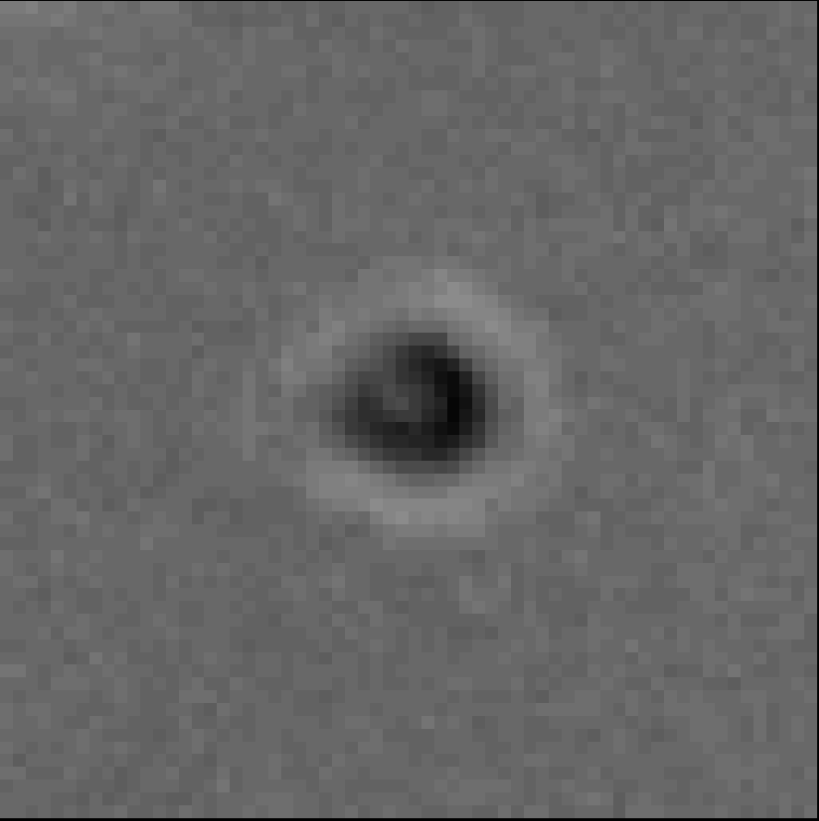
Cells move out of focus due to z direction movement
t=0
t=1
t=2
t=3
Offset
Plane in focus
Offset
y
x
Notes:
However, problem of 2D arises when imaging cells like T lymphocytes, which are capable of moving in Z-directions.
The video is showing the T cells even though they were initially placed to be in focus, they freely move in and out of focus due to Z displacement.
I have shown one example, as time progresses this T cell get very blurry and the corresponding movement is shown where this cell was indeed moving in Z.
As you can see from this picture also, that if your offset is larger and larger the cell becomes blurry and very difficult to track.

Slide 4
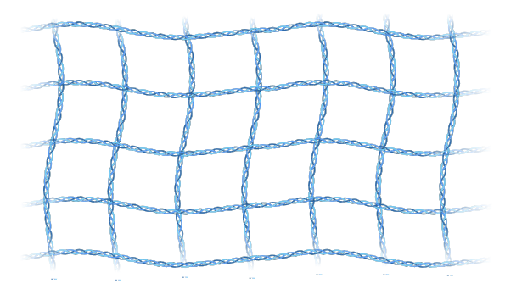
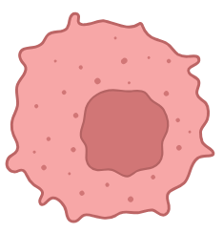
Objective
Actual 3D behavior
2D Image in the microscope
z
xy plane
From the projections of out of focus planes, reconstruct 3D shape and behavior using deep neural network
Notes:
Therefore, my objective is from these offset planes, reconstruct the 3D shape and behaviors in single-cell by utilizing deep neural network.

Slide 5
Methods
Notes:
I will talk about the methods.

Slide 6
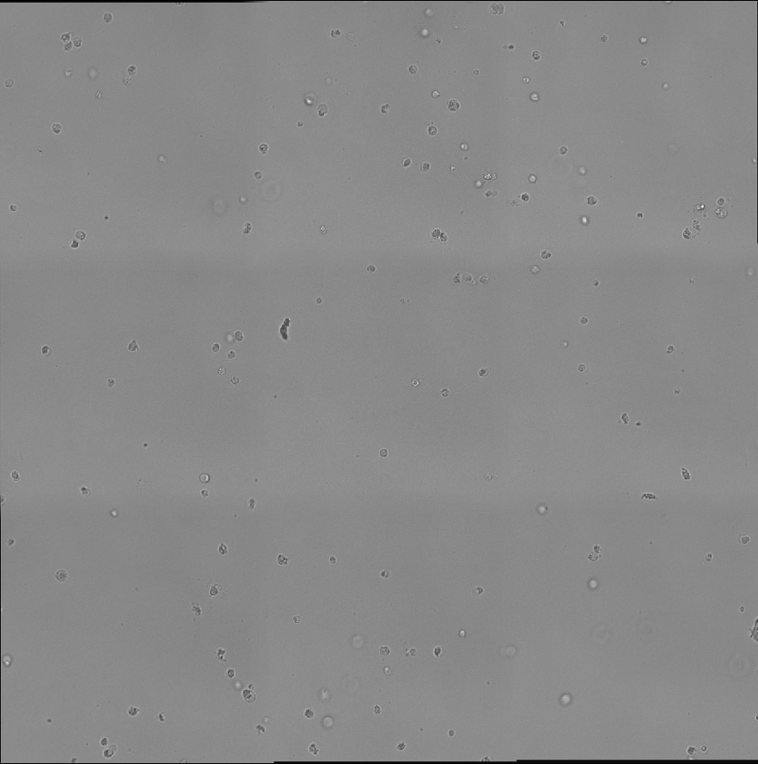
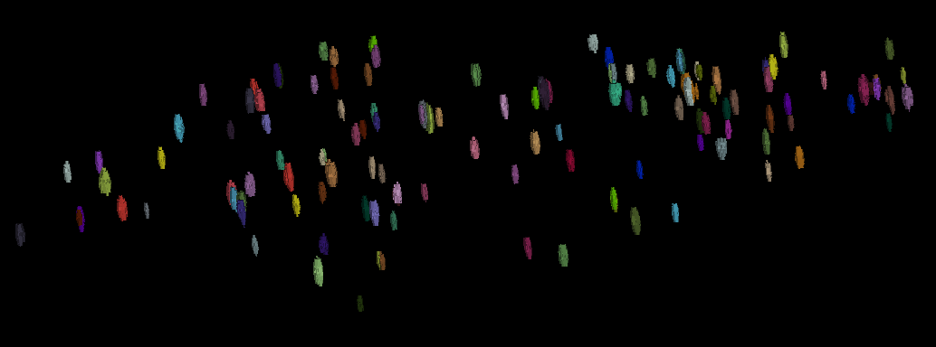
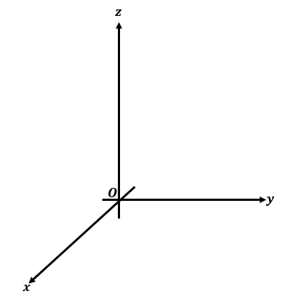
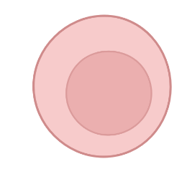
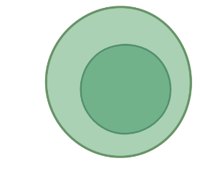

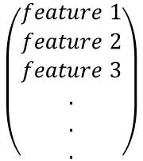
Overall pipeline
STEP 1
Infer 3D shape and position
(x(t), y(t), z(t))
$$\left(\begin{matrix}feature 1 \\ feature 2 \\ \begin{aligned}feature 3 \\ . \\ . \\ .\end{aligned}\end{matrix}\right)$$
STEP 2
STEP 3
Tracking trajectory of individual cells
Extract behavioral features
Notes:
This is the overall pipeline of the project.
First, from slices of brightfield image, neural network will be trained to infer both 3D shape and position.
Once the shapes and positions are predicted, we will utilize tracking algorithm to link the cells in consecutive frames to construct movement trajectories of single cells.
Next, autoencoder will be used to extract latent features by reconstructing the same 3D trajectory and create behavior space.

Slide 7
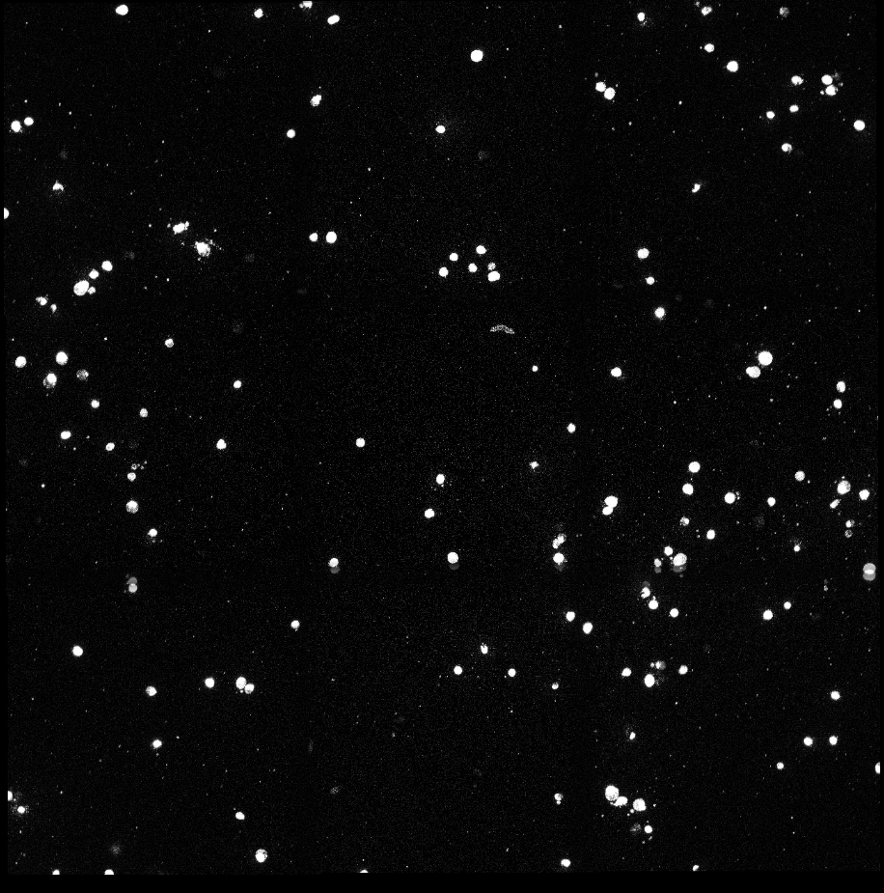
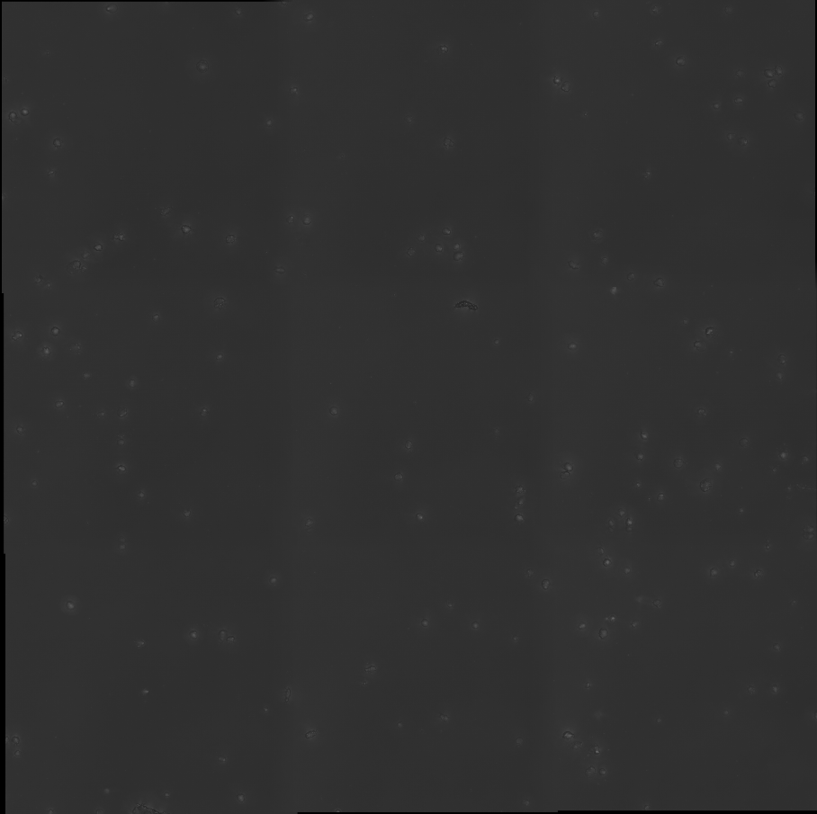
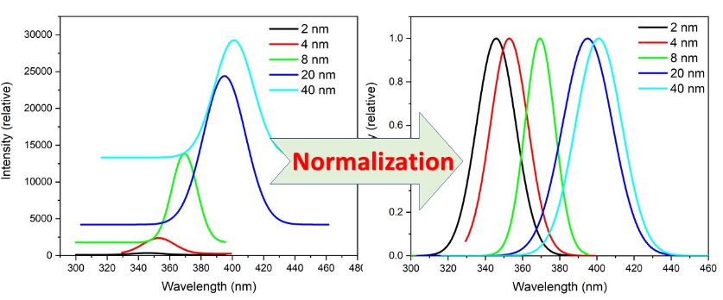
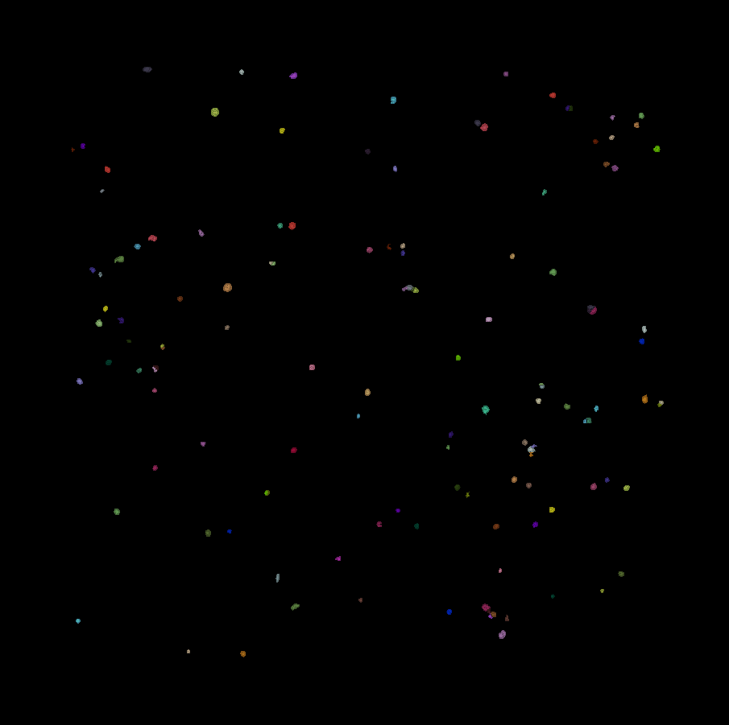
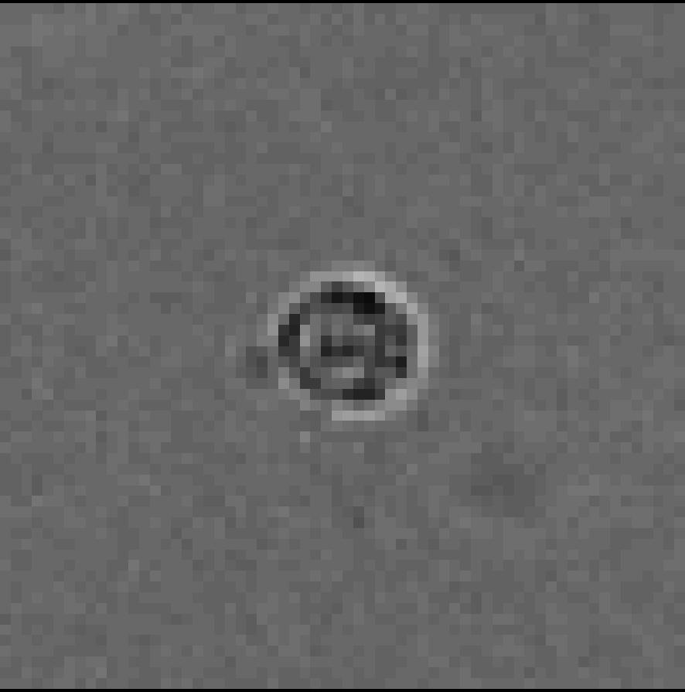
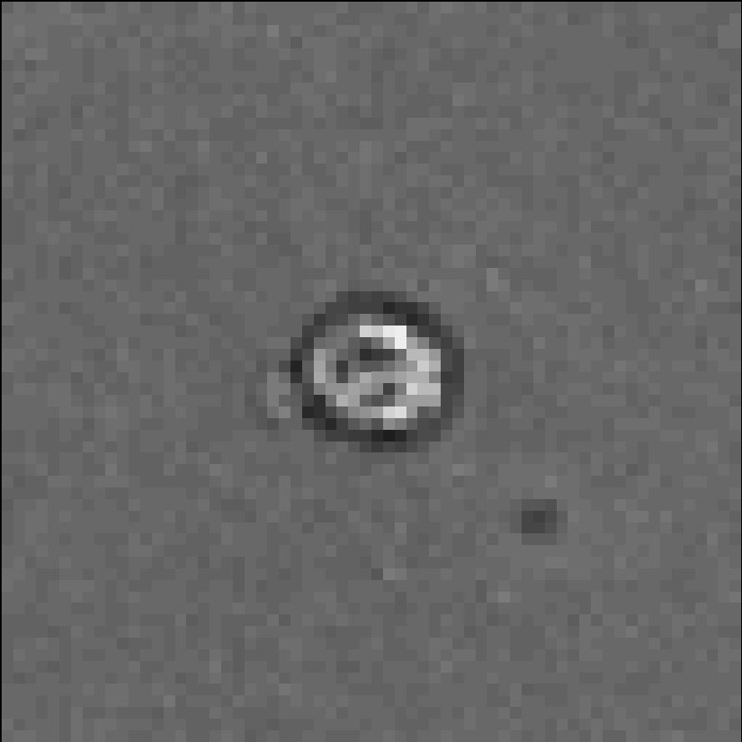
Training set preparation
Data acquisition
Preprocessing
3D segmentation
Post processing
Brightfield out-of focus z stacks
Normalization
Apply volume filter
Clear boundary objects
Voronoi-otsu labelling
Corresponding fluorescent z stacks
Z-direction interpolation
Remove touching objects
Added
Create 3D bounding box
Notes:
To elaborate more, first in order to prepare the training dataset, I collected brightfield out-of-focus z stacks and corresponding fluorescent z stacks.
Next is the preprocessing step, which includes image normalization to make intensity variation for each image to be consistent.
Due to technical issues of 3D time-lapse imaging, we can only get few z stacks at each time point.
So I performed linear interpolation in Z-direction and generated pseudo images in between to increase the resolution in Z.
Fluorescent Z stacks undergo Voronoi-otsu labelling for 3D instance segmentation to be used as ground truth for the model.
Finally, post processing step is required to remove any small objects that are debris, remove the objects that touch the border and nearby object.

Slide 8
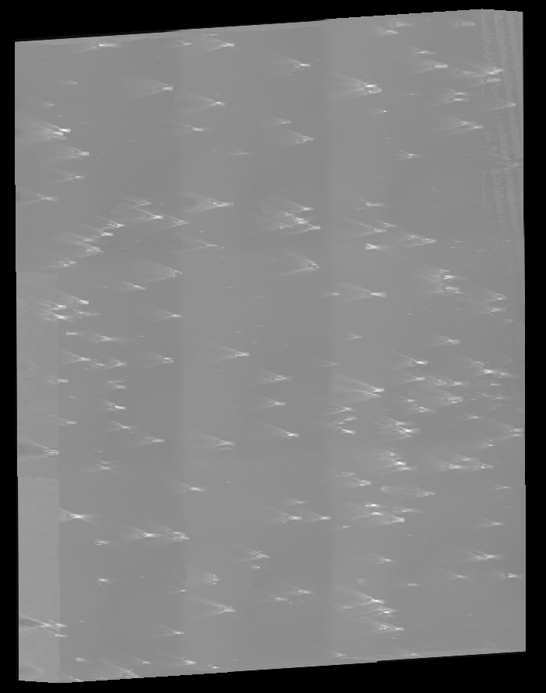

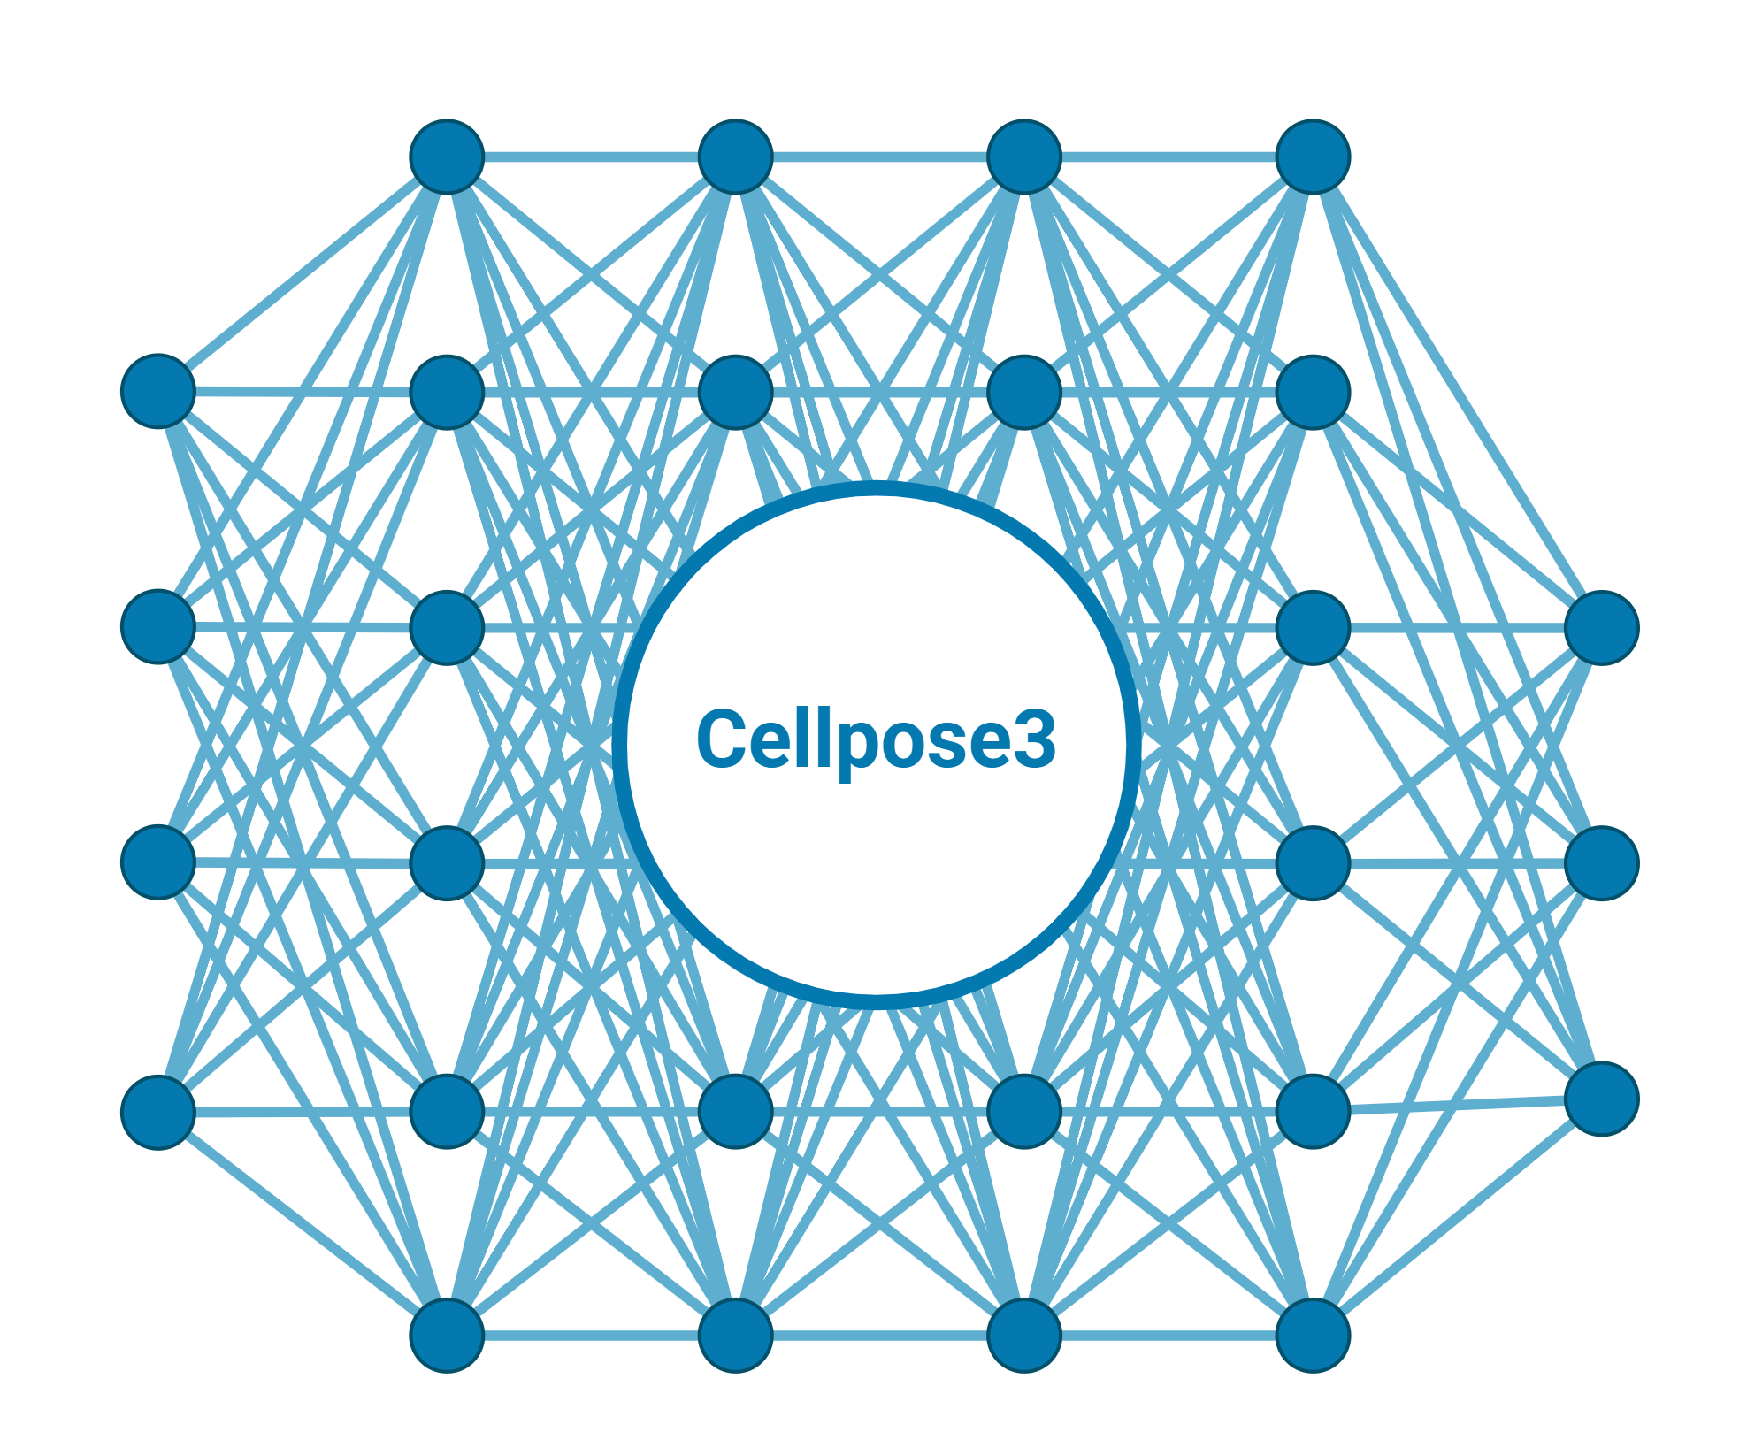
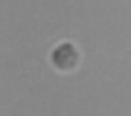
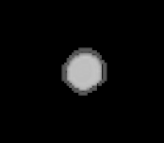

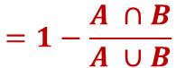
2D to 3D reconstruction network
Stringer, C., et. al., 2024
Brightfiled z stacks
Ground truth
Inference phase
1 x 1432 x 1432
Hard attention
1 x 64 x 64 x 2
128
256
512
1024
512
256
128
32 x 64 x 64
Jaccard loss
$$=1−\frac{A ∩B}{A ∪B}$$

Slide 9
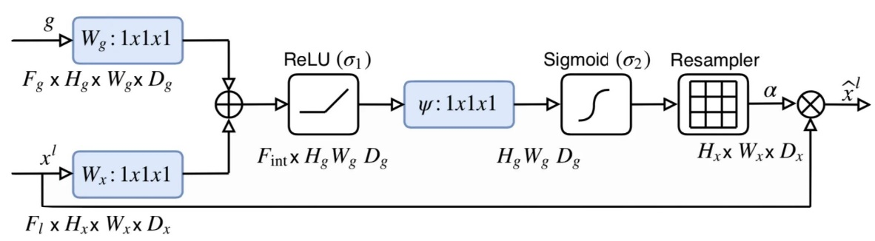
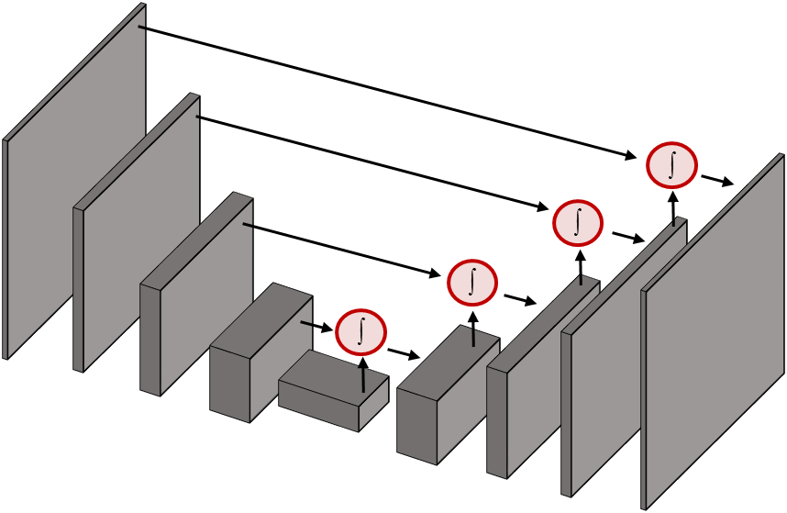
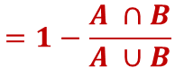
3D Attention Network
Schlemper, J., et. al., 2019
Brightfiled z stacks
Ground truth
Hard attention
52 x 1432 x 1432
Soft attention
Residual convolution block
Conv
3x3x3
Conv
3x3x3
32 x 64 x 64
Relu
Relu
128
256
512
1024
2048
1024
Jaccard loss
512
Conv
1x1x1
$$=1−\frac{A ∩B}{A ∪B}$$
256
128
32 x 64 x 64
Notes:
The model is now ready to be trained.
The model that I have built is the 3D Attention Network, which has U-net like architecture with two attention gates.
First attention is done by dividing the training set into multiple sub regions that mostly contain the region of interest.
Otherwise, the model can be biased towards learning only the backgrounds, which are not our interest.
The other attention gate connects the downsampling stage and upsampling stage where each layer is composed of convolutional blocks with skip connections or known as residual convolution.
Each upsampling layers are connected with attention gates from the same level downsampling layer, which reinforces the model to ‘pay attention’ to important features by using weights generated from the feature maps of the downsampling stage.
I used Jaccard loss which is given by 1 – intersection over union.

Slide 10
Tracking
t
t+1
t+2
t+3
. . .
t
t+1
Notes:
Once the model is trained, it can infer the 3D shape and positions in time.
I then used Crocker-Grier algorithm, which is based on Brownian motion of the particle and link the positions in consecutive frames by searching nearby region and choose the most probable object to be linked.
We iterate this for all cells in the ROI and for all frames

Slide 11
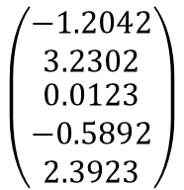
Extracting trajectory features
Encoder
Decoder
Causal 1D convolution
Latent
layer
(x, y, z)
(x, y, z)
.
.
Spatial 2D convolution
$$\left(\begin{matrix}−1.2042 \\ 3.2302 \\ \begin{aligned}0.0123 \\ −0.5892 \\ 2.3923\end{aligned}\end{matrix}\right)$$
Use to describe trajectory
Notes:
These trajectories are now trained by autoencoder that performs causal 1D convolution and spatial 2D convolution to gain spatiotemporal information and reconstruct the same 3D trajectory.
Once this model is sufficiently trained, the latent vectors are used as descriptions of the cell behavior and generate behavior space.

Slide 12
Results
Notes:
Now, I will move on to results.

Slide 13
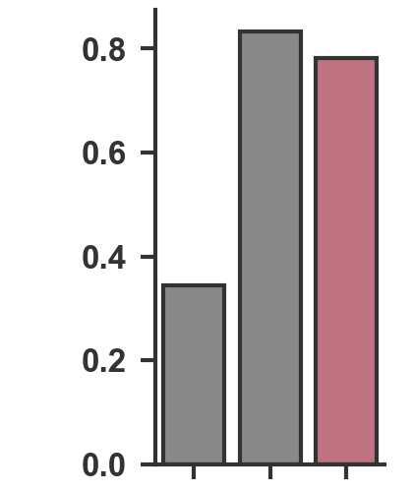
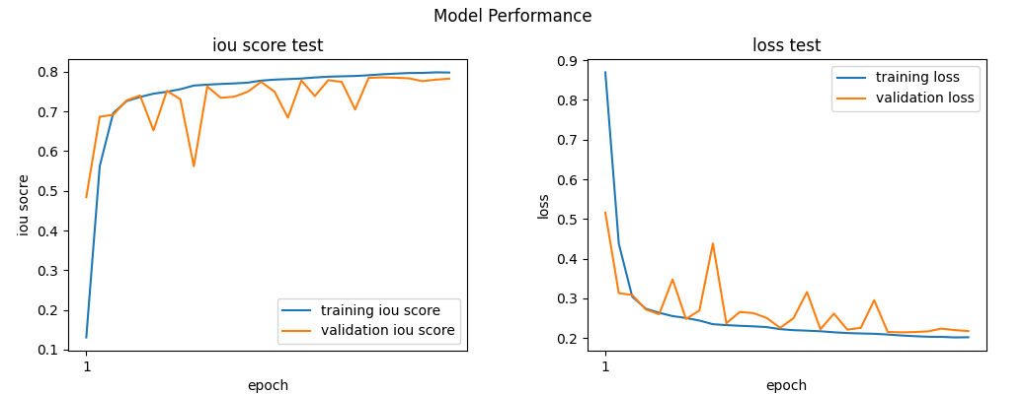
Model performance
Validation IoU score
3D AttentionNet
2D_3D ReconstructionNet
2D_3D ReconstructionNet (BF only)
Notes:
We compared the validation IOU score of the two models 2d_3d reconstruction net and 3D attentionnet.
First, we tested whether inputting brightfield slice alone can reconstruct 3D shape.
It turns out that it wasn’t successful as shown with low validation IOU score.
However, adding additional information with 2D segmented slice into 2d_3d reconstruction net results in much higher accuracy comparable to the accuracy of 3D attention net.
The iou score for 30 epochs are shown, and our model reached almost 0.8 in only 30 epochs.

Slide 14
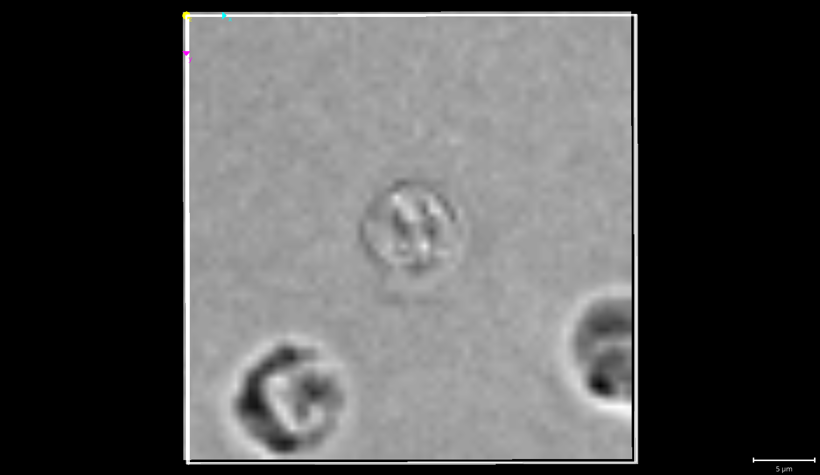
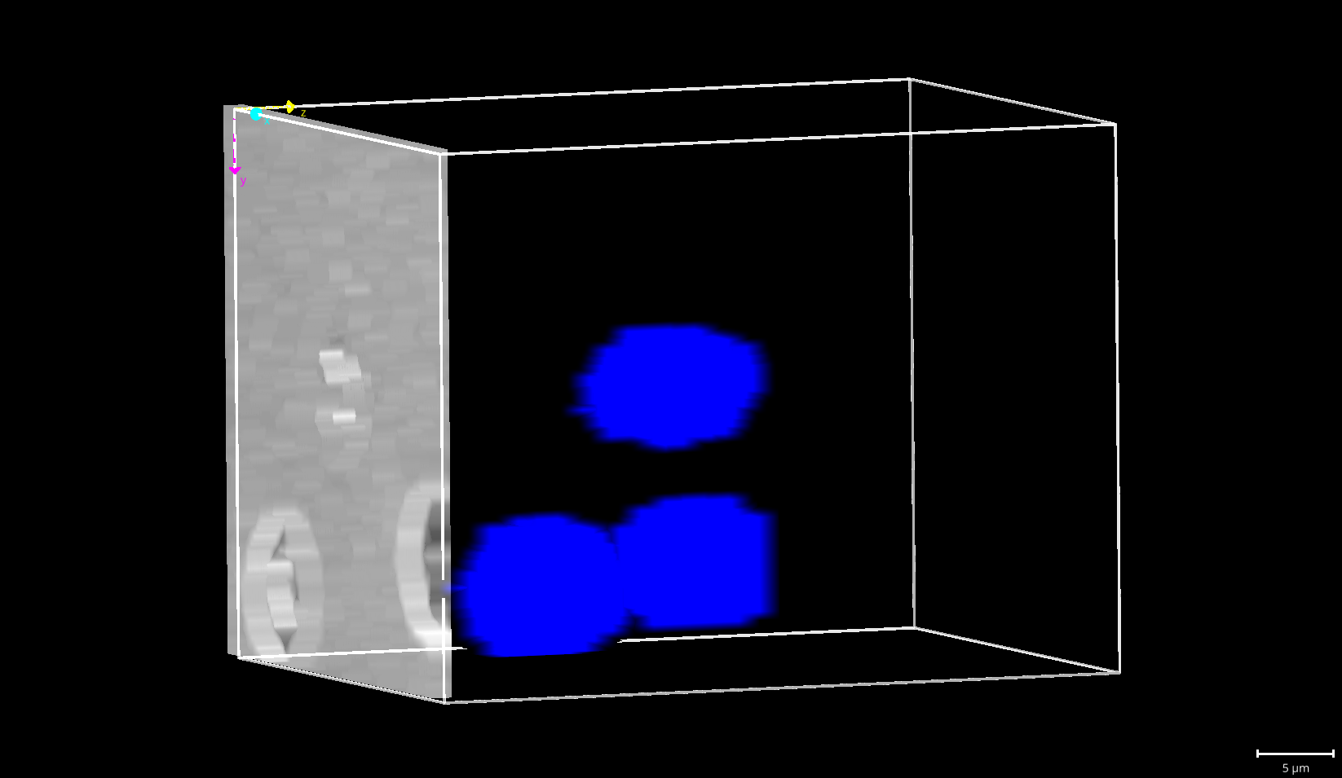
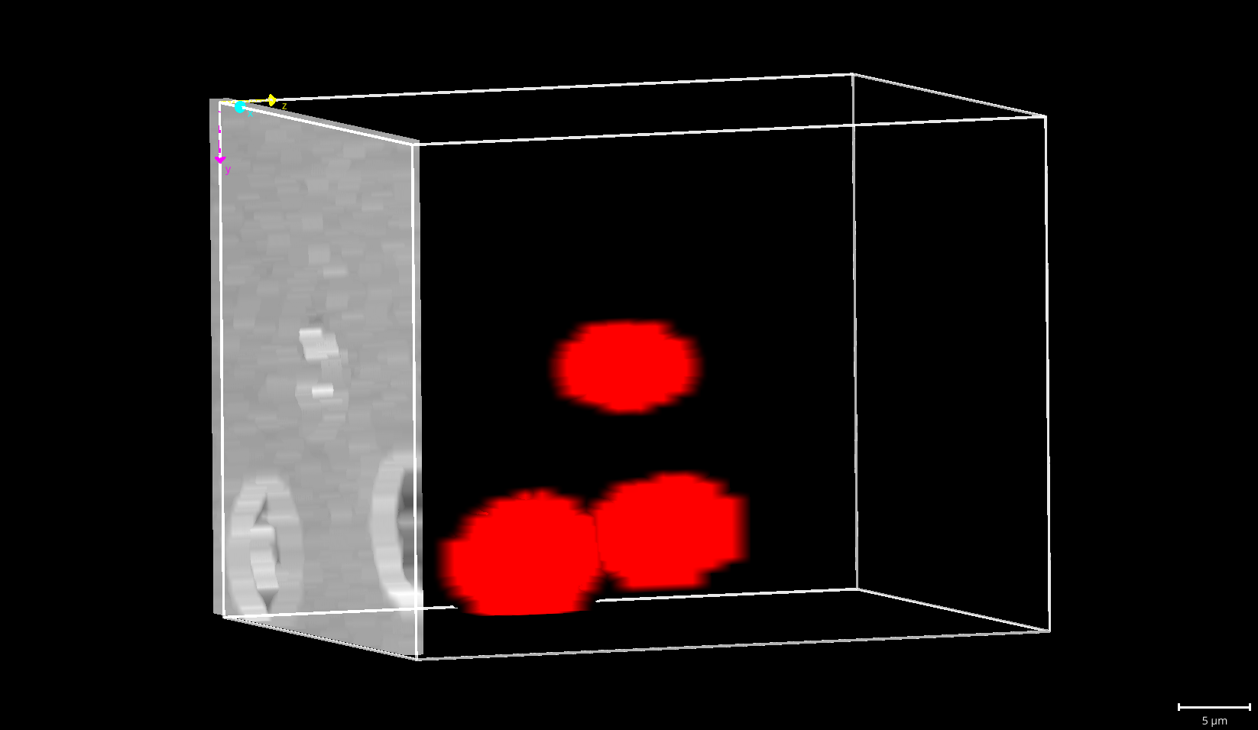
Prediction with single-cells in 2D_3D ReconstructionNet
2D Brightfield slice
Truth 3D cell shapes and positions
Predicted 3D cell shapes and positions
2D_3D ReconstructionNet accurately reconstructs the 3D shape
Notes:
Here is the prediction result from 2d_3d reconstruction net when we input the 2D slice of few cells.
We observed that the predicted 3D shape (shown in red) closely aligns with the true 3D shape (shown in blue)
Therefore, our 2d_3d reconstruction net is capable of accurately reconstructing the 3D shape.

Slide 15
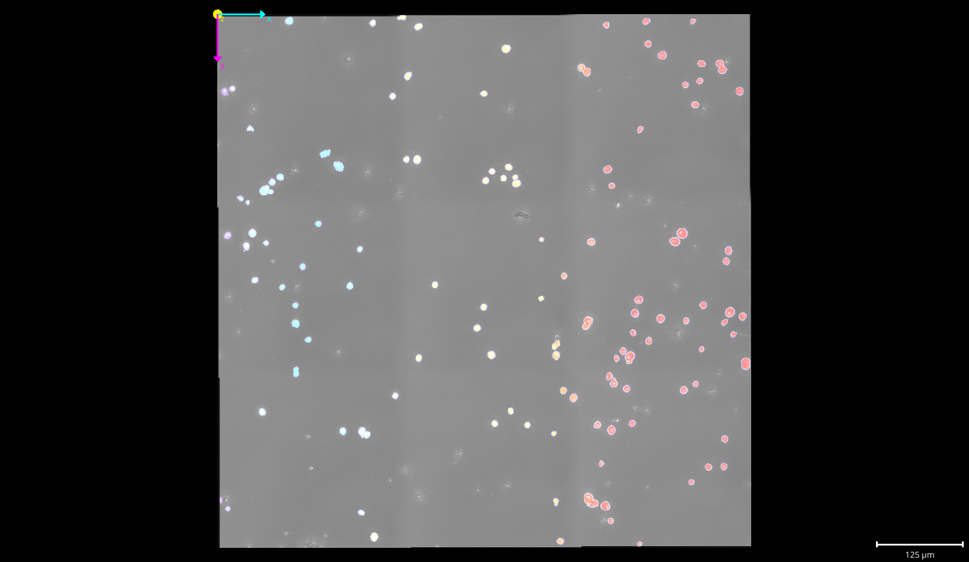
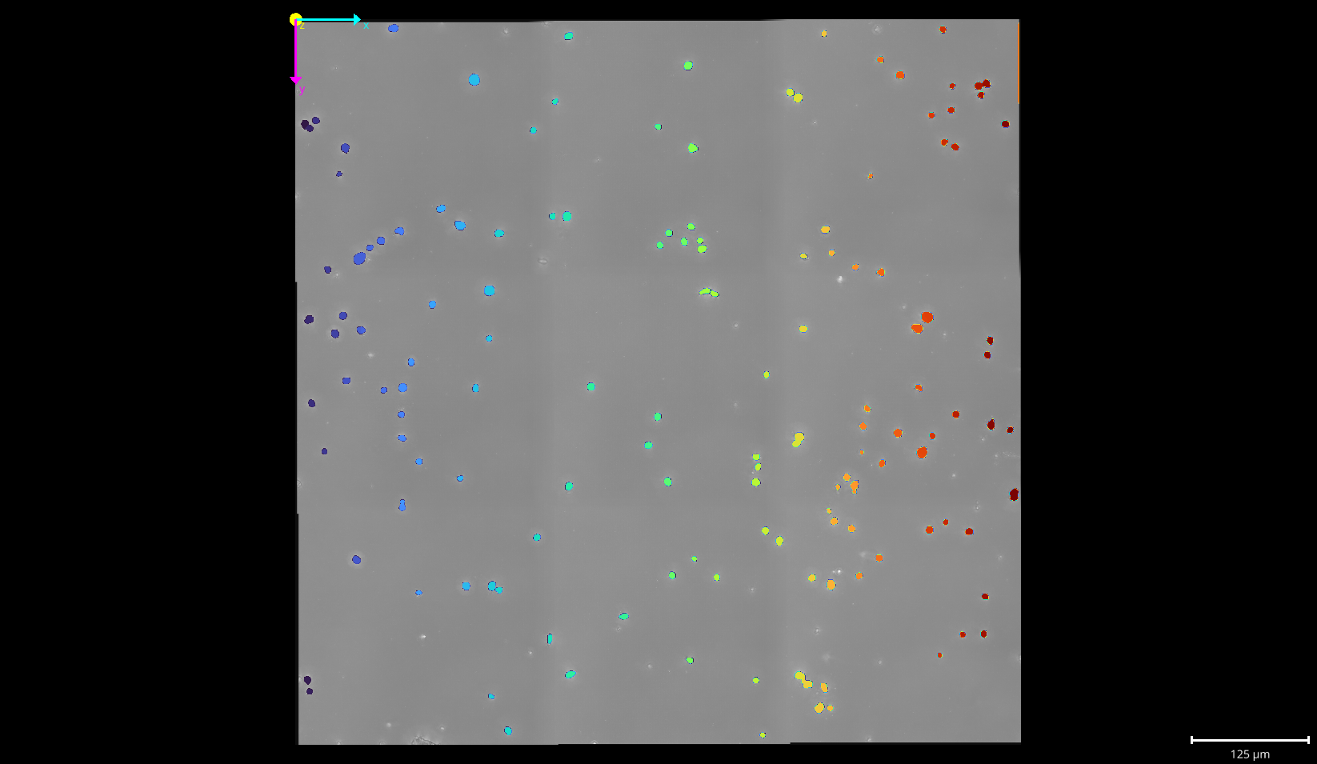
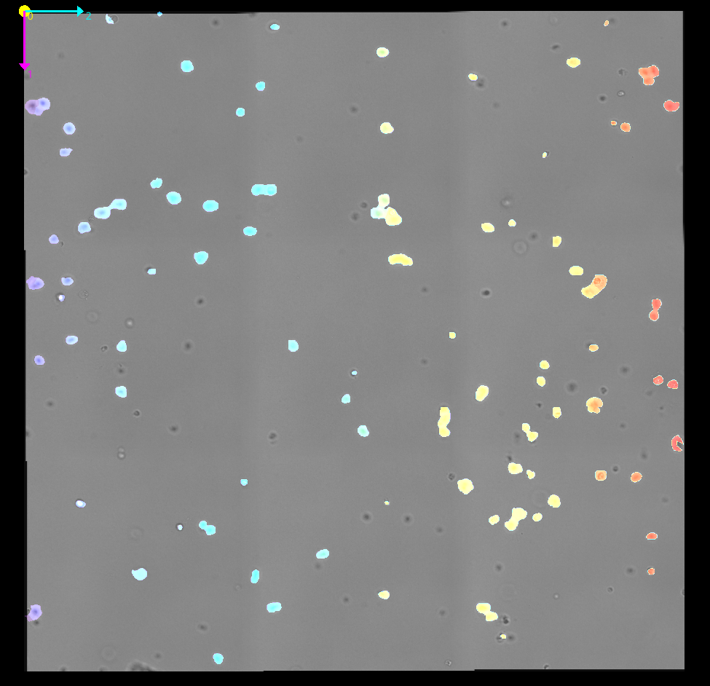
XY projection on the whole ROI
Truth
3D AttentionNet
2D_3D ReconstructionNet
X
Y
2D_3D ReconstructionNet accurately capture XY positions
Notes:
The prediction to the whole ROI (region of interest) is shown for both 3D attention net and 2d_3d reconstruction net.
In general, 2d_3d reconstruction net could accurately locate the cells in XY positions as much as 3D attention net.

Slide 16
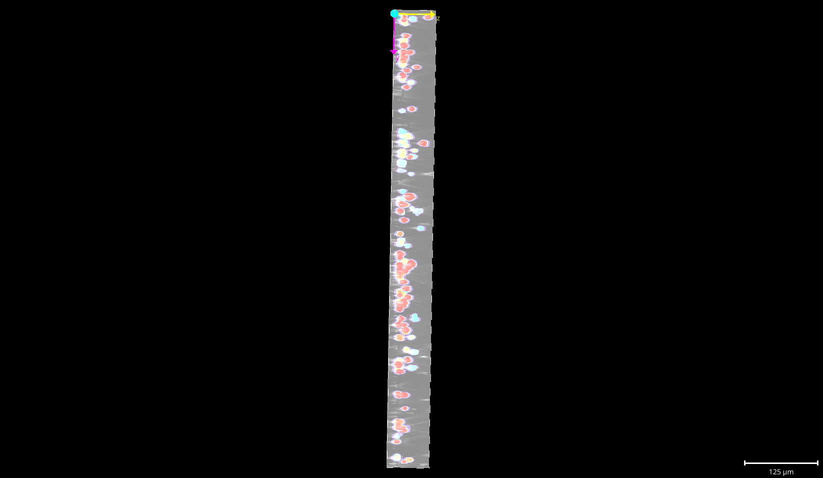
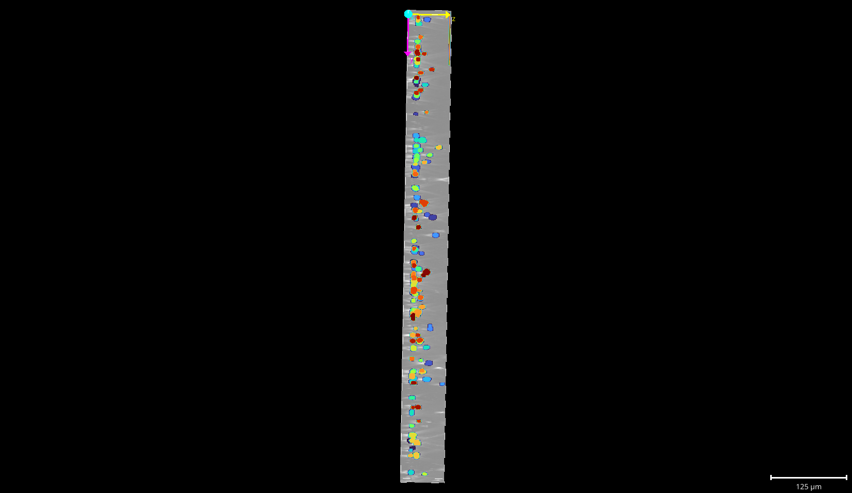
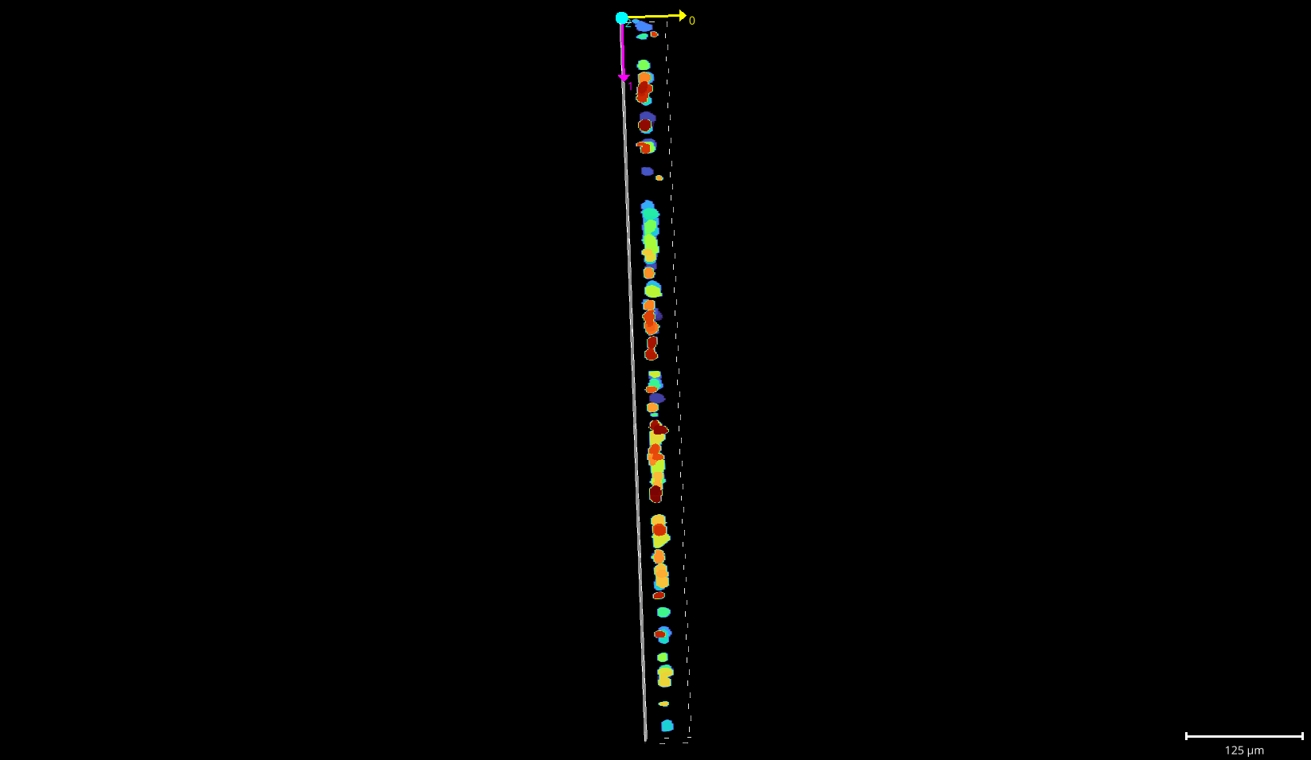
YZ projection on the whole ROI
Truth
3D AttentionNet
2D_3D ReconstructionNet
Z
Y
2D_3D ReconstructionNet fails to capture Z positions
Notes:
However, when we visualize the YZ plane, although the true labels express diverse range of z displacements
and the prediction from 3D attention net accurately mimics that range,
the 2d_3d reconstruction net fails to capture Z positions and have preference locating them on the center.
Due to this limitation, we proceeded with 3D Attention Net to capture 3D cellular behaviors.
YZ projections across the Region Of Interest
LEFT – GROUND TRUTH (for reference)
CENTRE - 3D AttentionNet (Improved accuracy in capturing the Z-axis positioning)
RIGHT - 2D_3D ReconstructionNet (struggles with Z-position predictions)
While network performs well for XY planes, its capacity to effectively extrapolate depth information needs improvement.

Slide 17
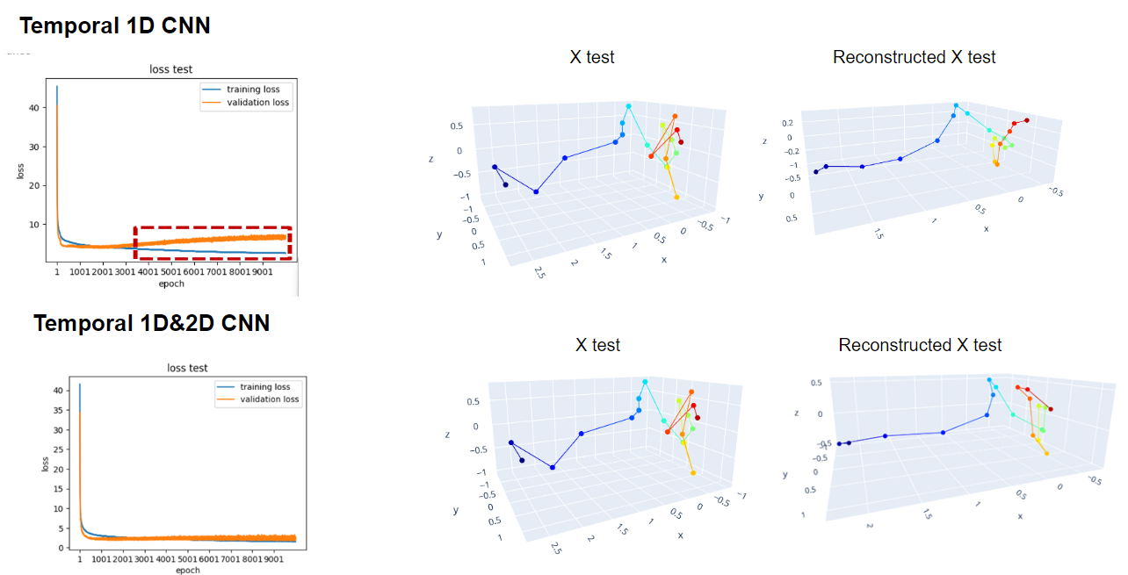
Model comparison for 3D trajectory reconstruction
+ LSTM
Notes:
Next, we demonstrate performance of 2 different autoencoders - first - utilizes 1D temporal convolution & LSTM, second - uses 1D and 2D spatio temporal convolution.
Training Loss and Validation loss of the first model diverges due to failure to depict rapid change in direction.
LSTM model renders the trajectory to be highly correlated in time, therefore it reconstructs very smooth trajectory.
training loss and validation loss from the second model both converge and capture the rapid fluctuations.

Slide 18
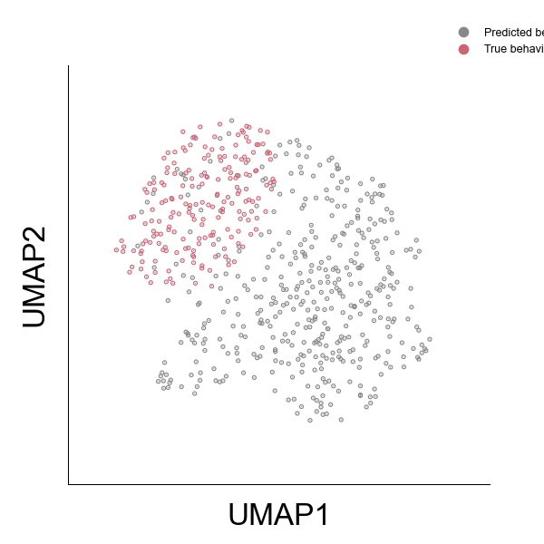
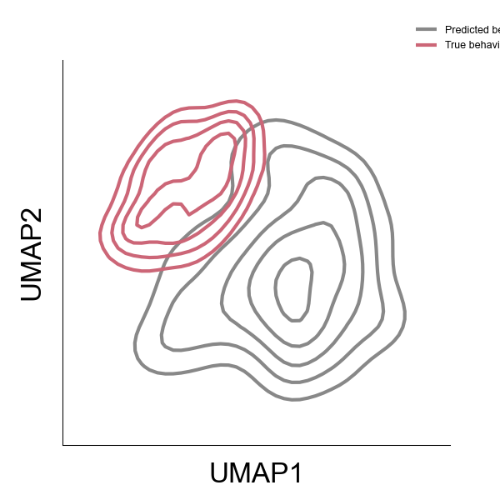
Behavior space show distinction between prediction and truth
(x, y, z)
.
Predicted behavior
20 frames
True behavior
Notes:
Build Behavior space using latent features - observe clear distinction b/w predicted and true behaviors over 20 frames.
Even though little bit of overlap in the truth space, the overall behavior space was governed by the variance of prediction behavior
this suggest potential areas for refinement, particularly in accurately representing finer details of cellular behavior.

Slide 19
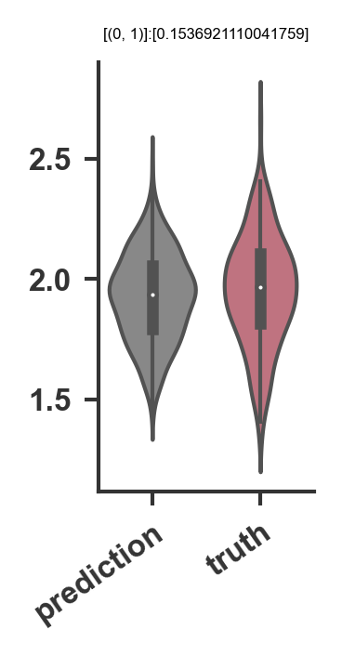
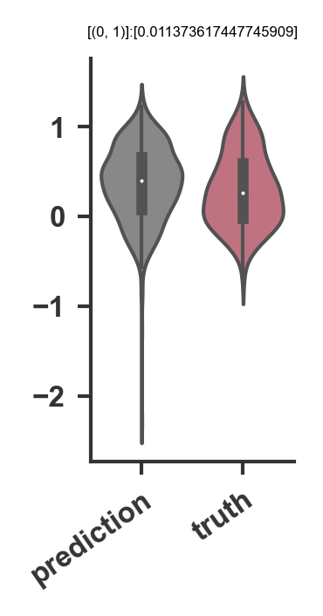
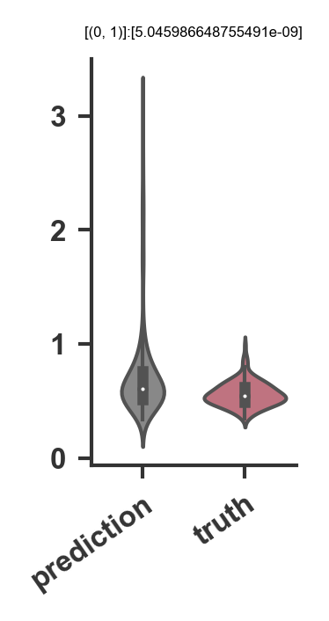
Predicted behaviors have high variance
N.S.
N.S.
***
Average turning angle (rad/frame)
Alpha
Instantaneous speed CoV
Deviation might be due to missed frames or small fluctuations
Notes:
A reasoning for this discrepancy can be that average turning angle and alpha, which calculates the mode of behavior is comparable.
avg turning angle (how sharply cells change direction during movement)
instantaneous speed (how fast a cell moves from one frame to the next)
However, we could see that coefficient of variance of instantaneous speed was significantly higher in the prediction, which we can infer that the predicted trajectories might have missed frames or small fluctuations that lead discrepancy between the truth.

Slide 20
Conclusion
Main takeaways:
2D_3D ReconstructionNet is highly effective in reconstructing 3D cell shape
3D AttentionNet is capable of predicting 3D cell movements
Temporal 1D&2D CNN autoencoder can reconstruct 3D cell behaviors via latent features
Movement behaviors of the truth and prediction display high discrepancy
Future plan:
Improve the 2D_3D ReconstructionNet to be capable of accurately inferring Z position
Investigate the reason for distinctive behaviors between truth and prediction
Train on cells with irregular 3D morphology e.g. fibroblasts
Notes:
Summarize:
2D_3D ReconstructionNet - highly effective in reconstructing 3D cell shapes. // HIGH ACCURACY
While the 3D AttentionNet excelled in predicting movements - there are significant differences b/w predicted & true behaviors - investigate further.
Moving forward - we aim to enhance the model's ability to infer Z positions so that it can map 3D behavior from single z slice using information from nearby slices - explore the reasons for behavioral discrepancies - train models on cells with irregular morphologies, such as fibroblasts.”

Slide 21

THANK YOU

Slide 22
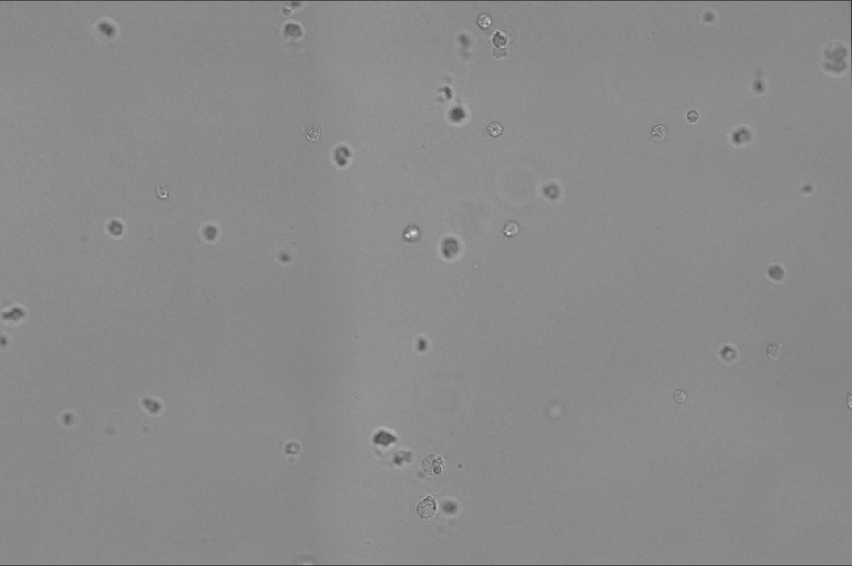
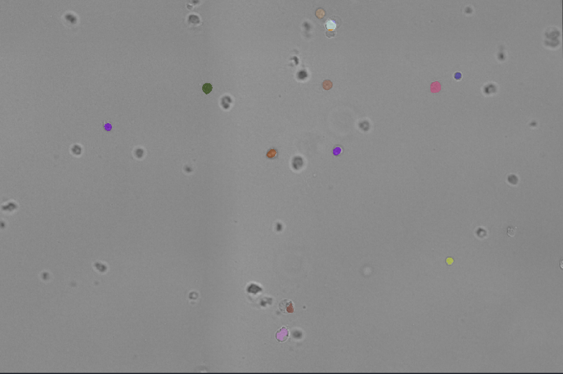
Model can pickup in-focus cells
Notes:
Other interesting ability of the model was that it could also detect the cells that are in-focus.
The Red boxes indicate the cells that are in the plane of focus, and you can see that model labeled the in-focus ones and didn’t label the out-of focus cells.

